Slide 1
Database Design and Implementation
Lecture 3
Normalization

Slide 2
Learning Outcomes
In this Lecture, students will learn:
  What normalization is and what role it plays in the database design process
  About the normal forms 1NF, 2NF, 3NF, BCNF,
  and 4NF
  How normal forms can be transformed from lower normal forms to higher normal forms
  That normalization and ER modeling are used concurrently to produce a good database design
  That some situations require denormalization to generate information efficiently

Slide 3
Agenda
This topic will cover:
  Normalization
  Need for Normalization
  Normalization Process
  Normal Forms
  Functional Dependence Concepts
  Conversion to Normal Forms
Notes:
NCC Education - Slide Master

Slide 4
Normalization
Evaluating and correcting table structures to minimize data redundancies
Reduces data anomalies
Normal forms
  First normal form (1NF)
  Second normal form (2NF)
  Third normal form (3NF)

Slide 5
Normalization
Structural point of view of normal forms
  Higher normal forms are better than lower normal forms
Denormalization: Produces a lower normal form higher normal form
  Results in increased performance and greater data redundancy

Slide 6
Need for Normalization
Used while designing a new database structure
  Analyzes the relationship among the attributes within each entity
  Determines if the structure can be improved
Improves the existing data structure and creates an appropriate database design

Slide 7
Normalization Process
Objective is to ensure that each table conforms to the concept of well-formed relations
  Each table represents a single subject
  No data item will be unnecessarily stored in more than one table
  All nonprime attributes in a table are dependent on the primary key
  Each table is void of insertion, update, and deletion anomalies

Slide 8
Normalization Process
Ensures that all tables are in at least 3NF
Higher forms are not likely to be encountered in business environment
Works one relation at a time
Starts by:
  Identifying the dependencies of a relation (table)
  Progressively breaking the relation into new set of relations

Slide 9
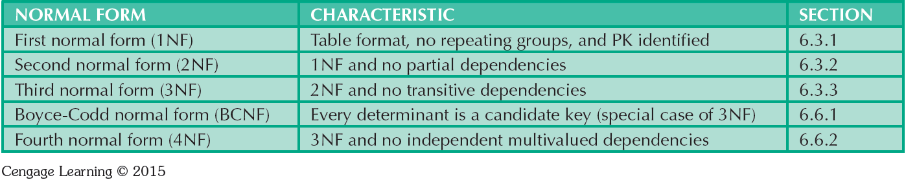
Normal Forms

Slide 10
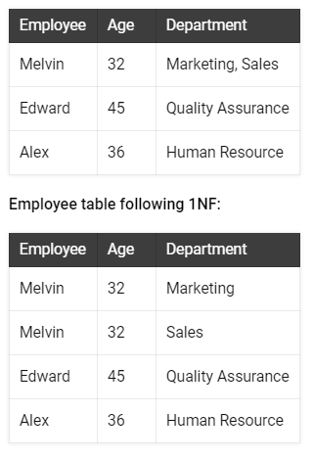
1NF

Slide 12
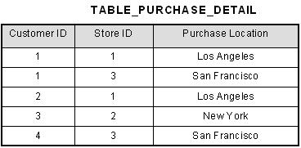
2NF

Slide 13
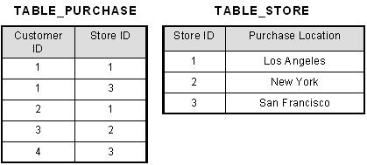

Slide 14
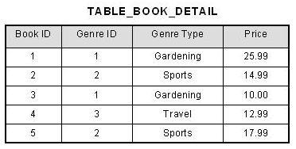
3NF

Slide 15
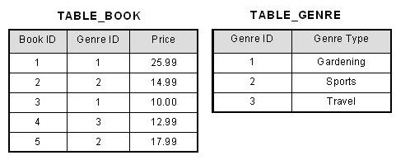

Slide 16
Functional Dependence Concepts
Concept | Definition
Functional dependence | The attribute B is fully functionally dependent on the attribute A if each value of A determines one and only one value of B.
Functional dependence (Generalized definition) | Attribute A determines attribute B if all of the rows in the table that agree in value for attribute A also agree in value for attribute B.
Fully functional dependence (composite key) | If attribute B is functionally dependent on a composite key A but not on any Subset of that composite key, the attribute B is fully functionally dependent on A.

Slide 17
Types of Functional Dependencies
Partial dependency: Functional dependence in which the determinant is only part of the primary key
  Assumption - One candidate key
  Straight forward
  Easy to identify
Transitive dependency: An attribute functionally depends on another nonkey attribute

Slide 18
Conversion to First Normal Form
Repeating group: Group of multiple entries of same type can exist for any single key attribute occurrence
  Existence proves the presence of data redundancies
Enable reducing data redundancies
Steps
  Eliminate the repeating groups
  Identify the primary key
  Identify all dependencies

Slide 19
Conversion to First Normal Form
Dependency diagram: Depicts all dependencies found within given table structure
  Helps to get an overview of all relationships among table’s attributes
  Makes it less likely that an important dependency will be overlooked

Slide 20
Conversion to First Normal Form
1NF describes tabular format in which:
  All key attributes are defined
  There are no repeating groups in the table
  All attributes are dependent on the primary key
All relational tables satisfy 1NF requirements
Some tables contain partial dependencies
  Subject to data redundancies and various anomalies

Slide 21
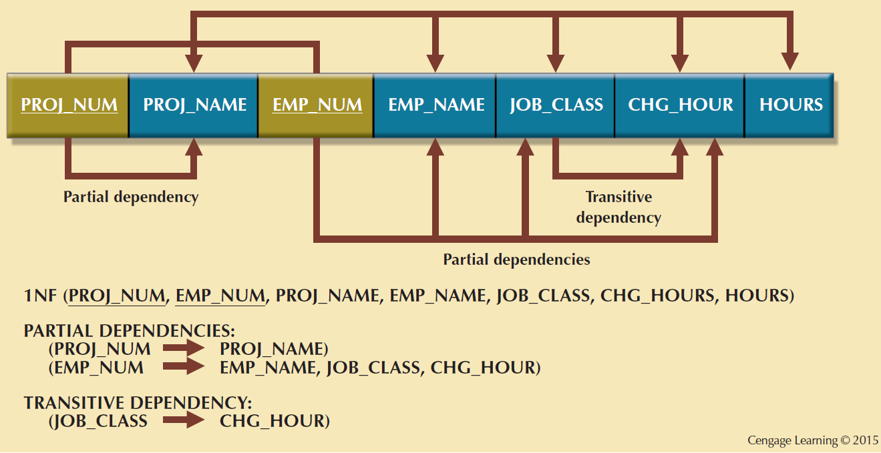
First Normal Form (1NF) Dependency Diagram

Slide 22
Conversion to Second Normal Form
Steps
  Make new tables to eliminate partial dependencies
  Reassign corresponding dependent attributes
Table is in 2NF when it:
  Is in 1NF
  Includes no partial dependencies

Slide 23
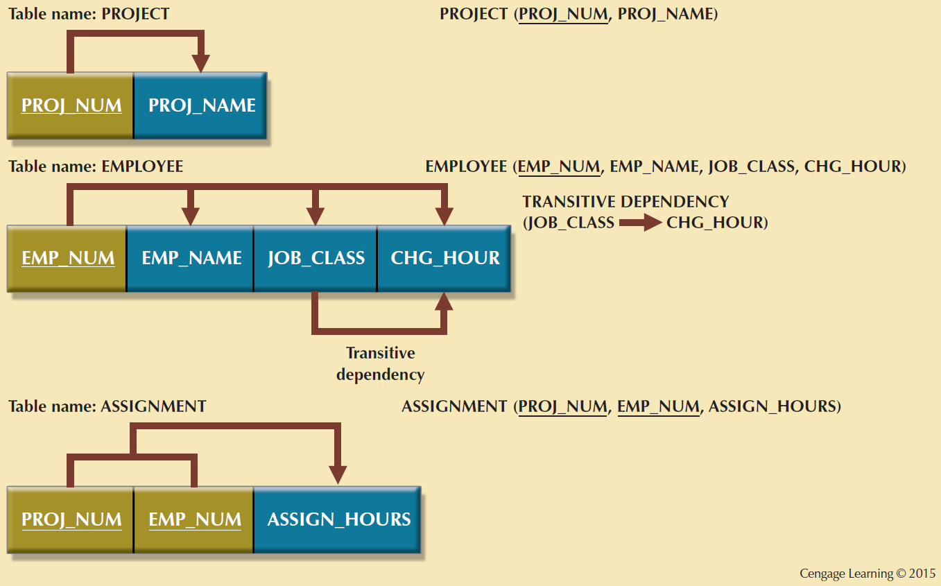
Second Normal Form (2NF) Conversion Results

Slide 24
Conversion to Third Normal Form
Steps
  Make new tables to eliminate transitive dependencies
    Determinant: Any attribute whose value determines other values within a row
  Reassign corresponding dependent attributes
Table is in 3NF when it:
  Is in 2NF
  Contains no transitive dependencies

Slide 25
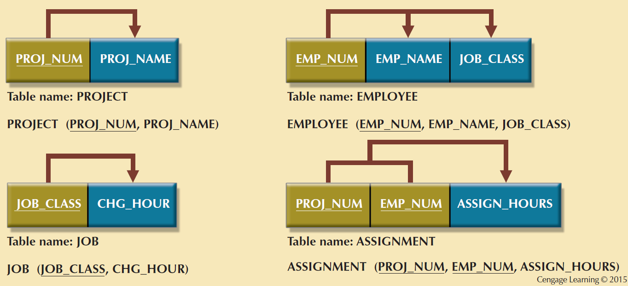
Third Normal Form (3NF) Conversion Results

Slide 26
Requirements for Good Normalized Set of Tables
Evaluate PK assignments and naming conventions
Refine attribute atomicity
  Atomic attribute: Cannot be further subdivided
  Atomicity: Characteristic of an atomic attribute
Identify new attributes and new relationships
Refine primary keys as required for data granularity
  Granularity: Level of detail represented by the values stored in a table’s row
Maintain historical accuracy and evaluate using derived attributes

Slide 27
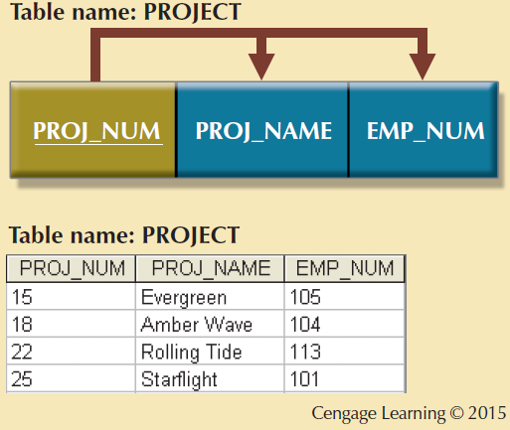
The Completed Database

Slide 28
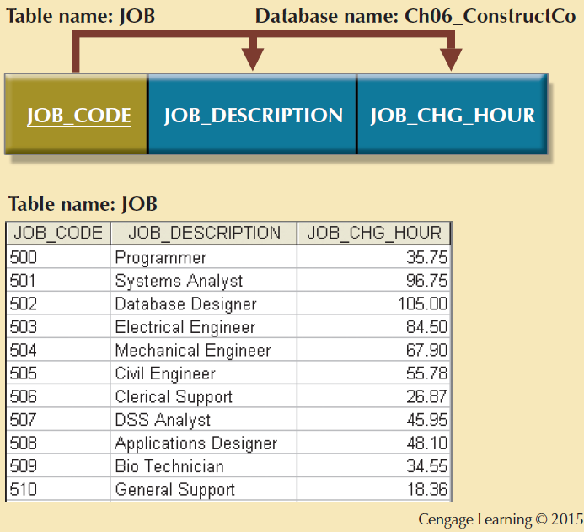
The Completed Database

Slide 29
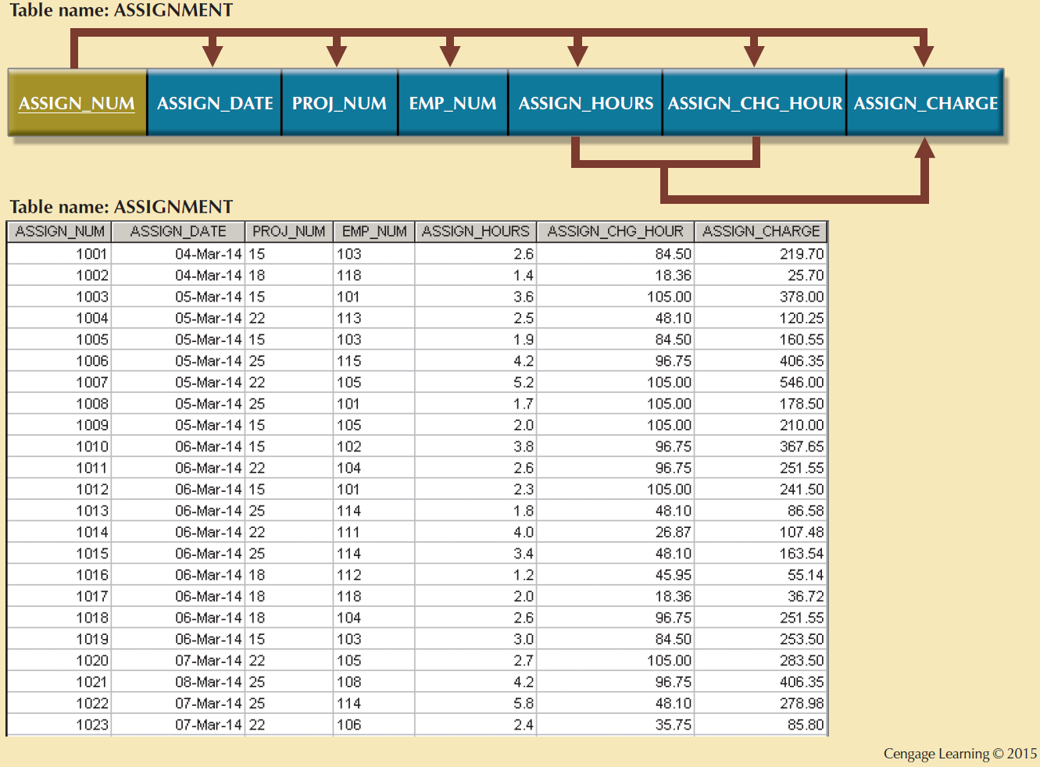
The Completed Database

Slide 30
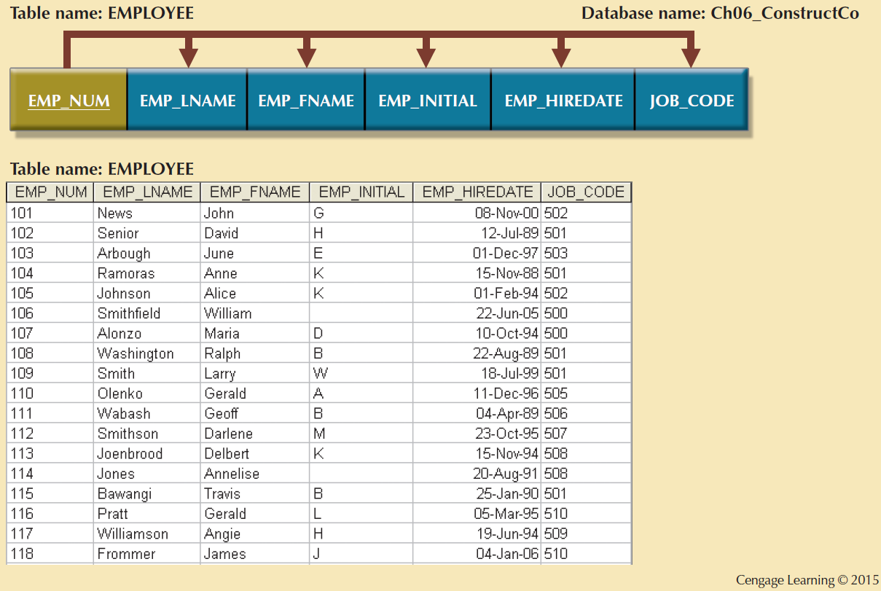
The Completed Database

Slide 31
Surrogate Keys
Used by designers when the primary key is considered to be unsuitable
System-defined attribute
Created an managed via the DBMS
Have a numeric value which is automatically incremented for each new row

Slide 32
The Boyce-Codd Normal Form (BCNF)
Every determinant in the table should be a candidate key
  Candidate key - Same characteristics as primary key but not chosen to be the primary key
Equivalent to 3NF when the table contains only one candidate key
Violated only when the table contains more than one candidate key
Considered to be a special case of 3NF

Slide 33
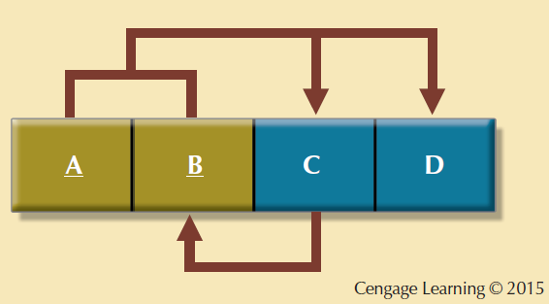
A Table That is in 3NF and not in BCNF

Slide 34
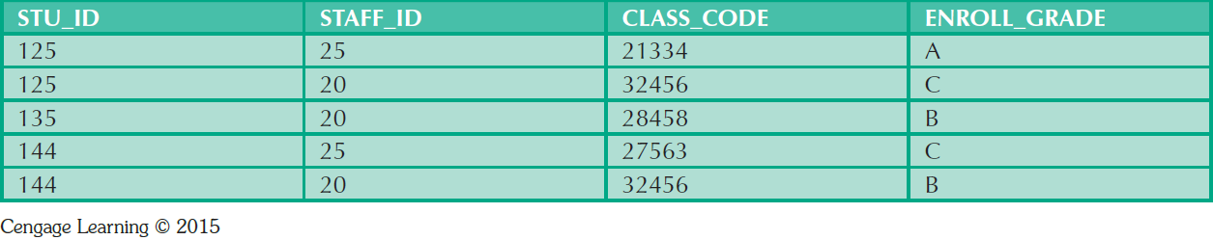
Sample Data for a BCNF Conversion

Slide 35
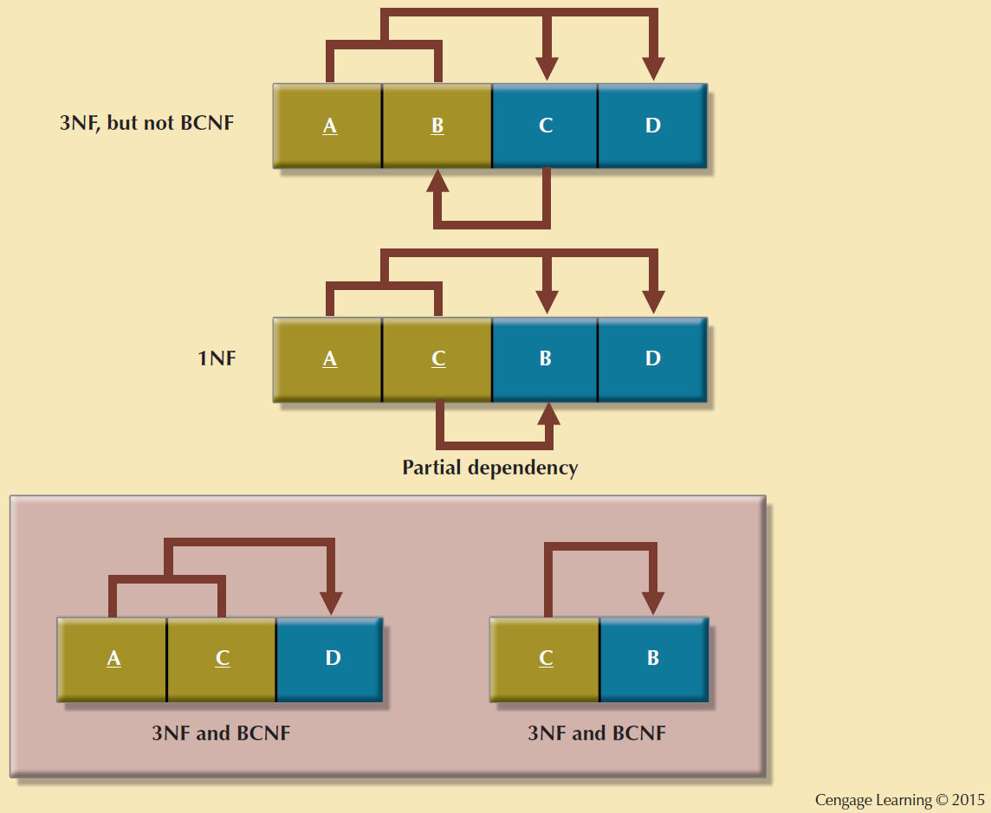
Decomposition to BCNF

Slide 36
Fourth Normal Form (4NF)
Table is in 4NF when it:
  Is in 3NF
  Has no multivalued dependencies
Rules
  All attributes must be dependent on the primary key, but they must be independent of each other
  No row may contain two or more multivalued facts about an entity

Slide 37
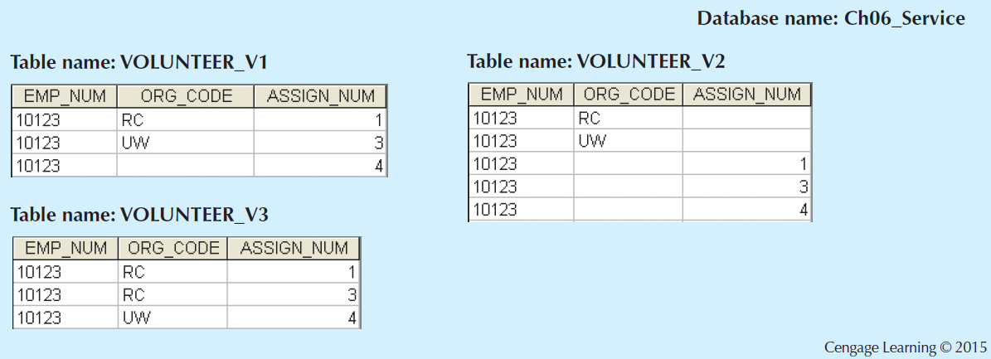
Tables with Multivalued Dependencies

Slide 38
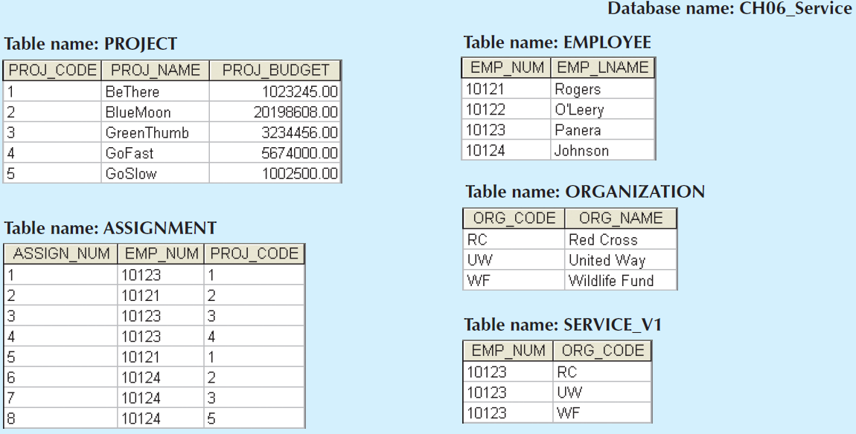
A Set of Tables in 4NF
Cengage Learning © 2015

Slide 39
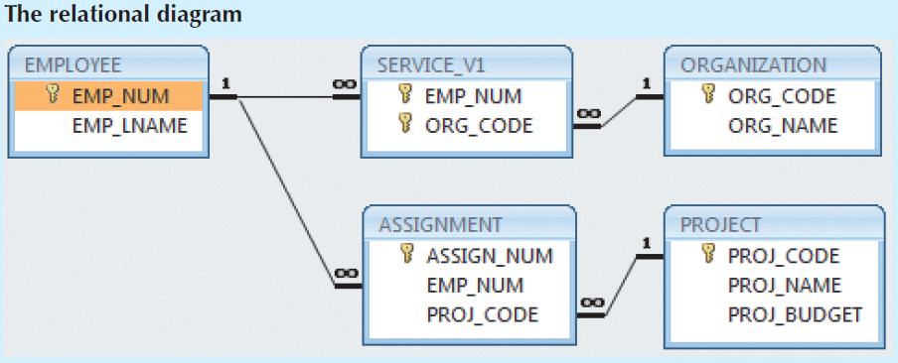
A Set of Tables in 4NF
Cengage Learning © 2015

Slide 40
Normalization and Database Design
Normalization should be part of the design process
Proposed entities must meet required the normal form before table structures are created
Principles and normalization procedures to be understood to redesign and modify databases
  ERD is created through an iterative process
  Normalization focuses on the characteristics of specific entities

Slide 41
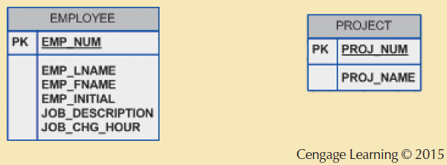
Initial Contracting Company ERD

Slide 42
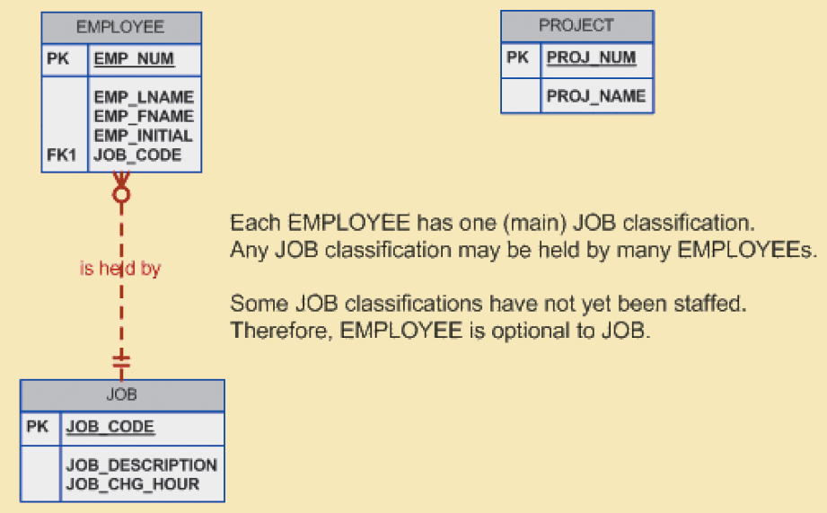
Modified Contracting Company ERD
Cengage Learning © 2015

Slide 43
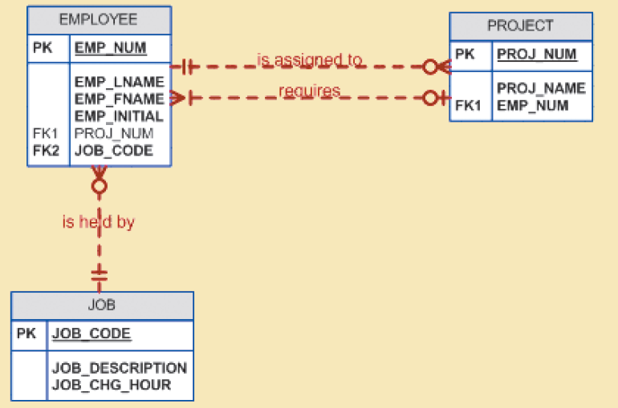
Incorrect M:N Relationship Representation
Cengage Learning © 2015

Slide 44
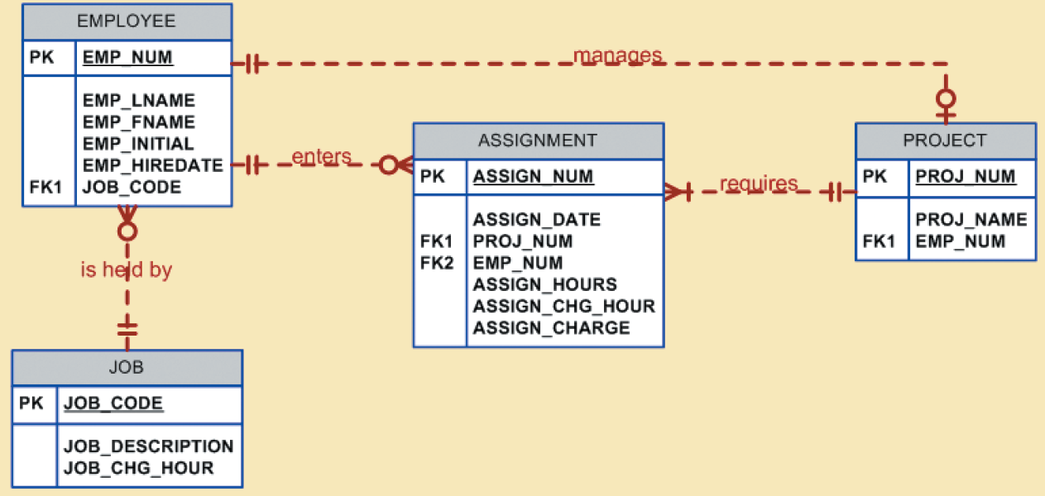
Final Contracting Company ERD
Cengage Learning © 2015

Slide 45
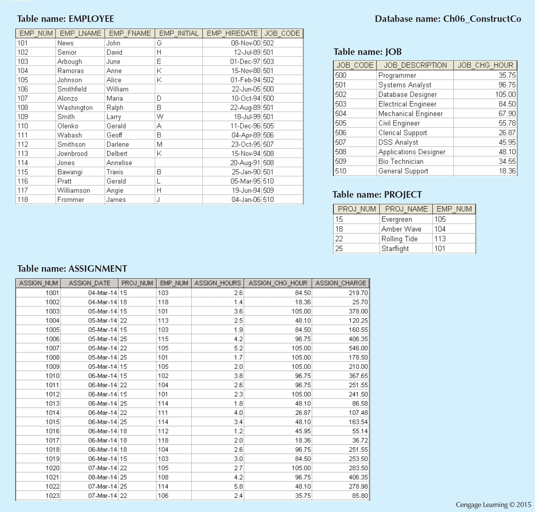
The Implemented Database

Slide 46
Denormalization
Design goals
  Creation of normalized relations
  Processing requirements and speed
Number of database tables expands when tables are decomposed to conform to normalization requirements
Joining a larger number of tables:
  Takes additional input/output (I/O) operations and processing logic
  Reduces system speed

Slide 47
Denormalization
Defects in unnormalized tables
  Data updates are less efficient because tables are larger
  Indexing is more cumbersome
  No simple strategies for creating virtual tables known as views

Slide 48
References
Database Systems: Design, Implementation, and Management by Carlos Coronel and Steven Morris,13th Edition, Cengage, Chapter 6 and 5.
Database Systems A Practical Approach to Design, Implementation and Management by Thomas Connolly and Carolyn Begg, Sixth Edition, Pearson, Chapter 14

